Slide 1


SAP UI5 & FIORI with OData TRAINING using BAS
Anubhav Oberoy
Day – 19

Slide 2

Agenda – Day 17
What is OData?
oData Basics.
Structure of Odata.
Client Side Query With Odata.
Get Operations.
SAP Deployment Options
TCodes and Services
Data Model for our use case
Creating OData Service.
Building Get Entity set Method
Testing the Get Entity set Method in Browser
Building Get Entity method (Single Product)
Introduction to the Postman Tool
Setting the Authorization in Postman
Testing Get Entity and Entity set using Postman
Implementing Create in OData Service
Testing POST calls in the SAP Logon
Testing POST calls using postman
How to set payload in postman to test POST call
Introduction to x-csrf-token
Implementing Update and Delete in service
Adding Supplier Entity set
Introduction to Association
Associating Supplier Set to Product Set
Introduction to Function Import
Creating a Function to get Most expensive product
Basics of Connectivity
Introduction to Cloud Connector
Steps to Setup the Cloud Connection.
Creating the destination in the BTP for BAS
Creating the destination in the Vscode

Slide 3
What is OData?
OData Stands for Open Data Protocol, It is an stateless protocol; it is an OASIS standard to communicate to server using REST(Represerntational state Transfer) based service. It was acquired by Microsoft in 2012 and adopted by many companies to build REST services to expose data over internet HTTP/HTTPs protocol.
Funda Fox
Fiori cannot talk to FM, program, CDS views, …. Fiori only and only talk to OData service which is built on top of FM, ABAP code, CDS view.

Slide 4
OData Basics
This OData Protocol is mainly used to expose data over HTTP. It does not matter from consumer point, which technology the OData is built on. This way we are abstracted from the underlaying programming/database. Fiori only and only understand OData, it cannot talk to BAPI, BADI, FM, CDS View, Interface, Class.
Lets start understanding a sample odata given by Microsoft on odata.org
1. Service document – is a collection of entity sets to access the data.
An Entity set is built by an Entity Type. Entity Set is the right end point to perform CURDQ operations
Entity Type describes the structure of the data – metadata
https://services.odata.org/V3/Northwind/Northwind.svc/
2. Service metadata document – describes all the properties and entity types
Which includes key, properties, attributes (nullable, key, max length, create), NavigationProperty
Also includes the relations between entities called association (compare with Foreign key)
Usually one database table is considered as one entity.
https://services.odata.org/V3/Northwind/Northwind.svc/$metadata
https://chrome.google.com/webstore/detail/jsonview/chklaanhfefbnpoihckbnefhakgolnmc
https://chrome.google.com/webstore/detail/xml-tree/gbammbheopgpmaagmckhpjbfgdfkpadb

Slide 5

Structure of an OData URL
http://stcfin.st.com:8021/sap/opu/odata/IWBEP/GWSAMPLE_BASIC/ProductSet?$format=json
http(s)://hostname:port/sap/opu/odata/sap/SERVICENAME_SRV/ENTITYSET?p1=val&p2=val
Protocol
Address & Port
Path prefix
Service Name
End Point Access Data
Query Options

Slide 6
Client Side Query with OData
Sets the page size of results.
02
$top
Indexes into a result set. Also used by some APIs to implement paging and can be used together with $top to manually page results.
Returns the results in the specified media format.
01
03
$format
$skip
ODATA Query
06
04
Retrieves related resources.
Filters properties (columns).
$expand
$select
05
$filter
Filters results (rows).

Slide 7
GET operations
Read All the data from Products (SELECT * FROM dbtab)
https://services.odata.org/V3/Northwind/Northwind.svc/Products?$format=json
Read few properties of entity (SELECT col1, col2 FROM dbtab)
https://services.odata.org/V3/Northwind/Northwind.svc/Products?$format=json&$select=ProductID,SupplierID
Read Top Records (Pagination SELECT * UP TO ROWS n ..)
https://services.odata.org/V3/Northwind/Northwind.svc/Products?$format=json&$top=3&$skip=10
Read data by filtering (SELECT * FROM dbtab WHERE condition)
https://services.odata.org/V3/Northwind/Northwind.svc/Products?$format=json&$filter=SupplierID%20eq%203
SELECT * FROM dbtab WHERE col LIKE ‘%pattern%’
https://services.odata.org/V3/Northwind/Northwind.svc/Products?$format=json&$filter=substringof(%27Cola%27,ProductName)%20eq%20true
Reading count of the records (SELECT COUNT(*) FROM dbtab)
https://services.odata.org/V3/Northwind/Northwind.svc/Products/$count
Reading Single record by its key (SELECT SINGLE * FROM edbtab WHERE pkey = ‘key’)
https://services.odata.org/V3/Northwind/Northwind.svc/Products(11)?$format=json
Join and read data together (SELECT * FROM tab1 INNER JOIN tab2 ON cond)
https://services.odata.org/V3/Northwind/Northwind.svc/Products(11)?$format=json&$expand=Supplier,Category
Association : It’s the relation between multiple Data , it is similar as foreign key relation in DB world
When we create association system will create the navigation property which we can use as a pointer to load the dependent data.

Slide 8

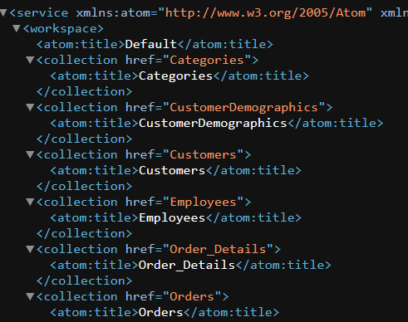
Hands-on : Get Operations
Practice all the get operations in the previous slide by your own on the northwind service url.
Links were given in the previous slide.

Slide 9
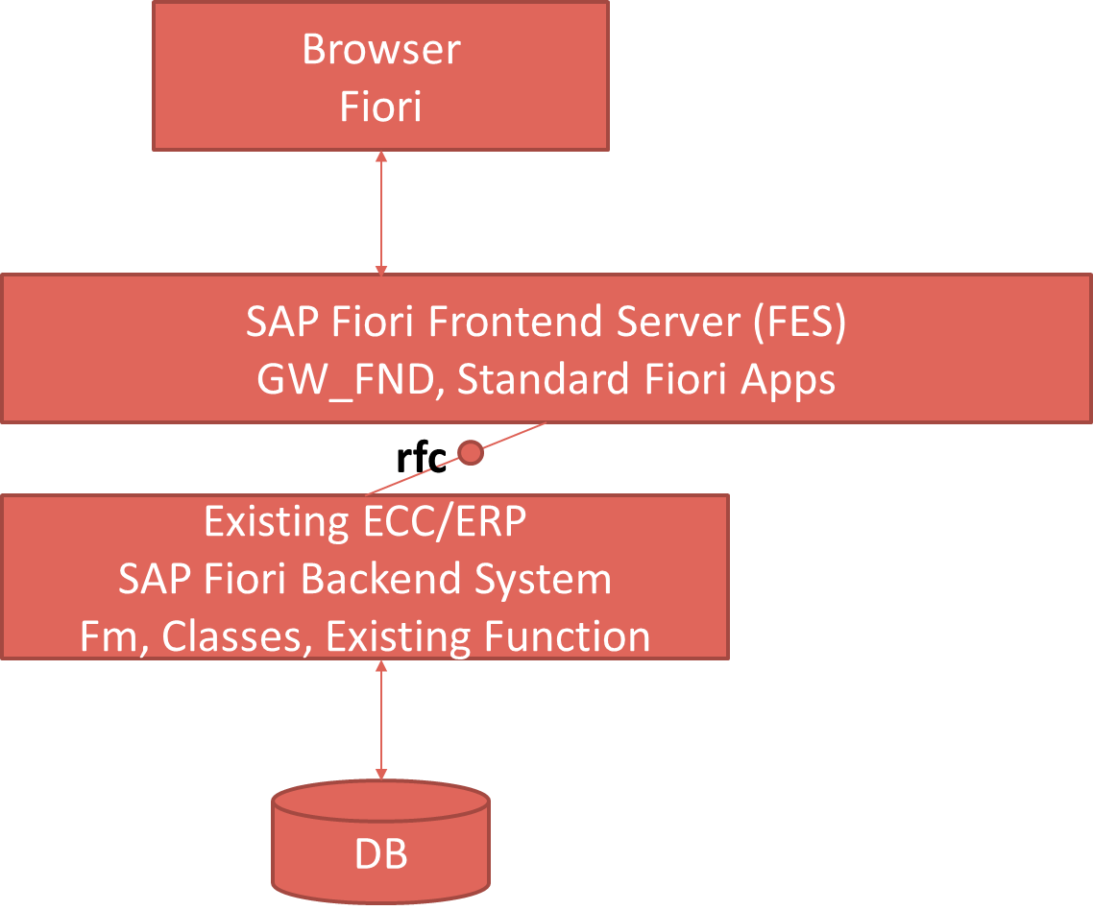
SAP Deployment Options
Central HUB Scenario
Embedded system
Browser
Fiori
SAP Fiori Frontend Server, GW_FND, Standard Fiori Apps
Existing ECC/ERP
SAP Fiori backend System
FM , Classes, existing Function
DB

Slide 10
Pros and Cons
Central HUB Deployment
Cons:
Manage multiple systems
Cost is high
Confusion
User needs to be duplicated
OData Metadata is duplicate
Pros
No need to upgrade
Separation of concerns
Works like a HUB
Recommendation
https://www.sap.com/documents/2018/02/f0148939-f27c-0010-82c7-eda71af511fa.html
Embedded Deployment (recommended)
Pros –
Less Costly
No confusion
No redundancy
Cons –
- Upgrade
- All load on one system

Slide 11
TCodes and Service
SEGW – SAP Service Gateway Builder
/n/IWFND/MAINT_SERVICE – Register the service
/n/IWFND/GW_CLIENT – gateway client – test locally
/n/IWFND/ERROR_LOG – Check errors, troubleshoot
EPM – Enterprise procurement model – Demo data model given by SAP for Training and demonstration.
ITeIO
SO
Customers
PO
Suppliers
Invoices
Stock

Slide 12






Slide 13
Data Model for our use case
EPM Data model = Enterprise Procurement Model
This is a sample data model for learning and education purpose since it is a demo model, we are not risking any productive objects in our system. The data model has Function Modules called as BAPI(Remote enabled FM).
All the BAPI starts with BAPI_EPM*
Products (SNWD_PD, SNWD_TEXTS)
BAPI_EPM_PRODUCT_GET_LIST – All the list of products
BAPI_EPM_PRODUCT_GET_DETAILS – Read single product by key
BAPI_EPM_PRODUCT_CREATE – Create new product
BAPI_EPM_PRODUCT_DELETE – Delete product
BAPI_EPM_PRODUCT_UPDATE – Change data of a product
Business Partners (SNWD_BPA)
BAPI_EPM_BP_GET_LIST – All the list of Business Partners
BAPI_EPM_ BP_GET_DETAILS – Read single Business Partners by key
BAPI_EPM_ BP_CREATE – Create new Business Partners
BAPI_EPM_ BP_DELETE – Delete Business Partners
BAPI_EPM_ BP_UPDATE – Change data of a Business Partners
Orders (SNWD_SO, SNWD_SO_I)

Slide 14
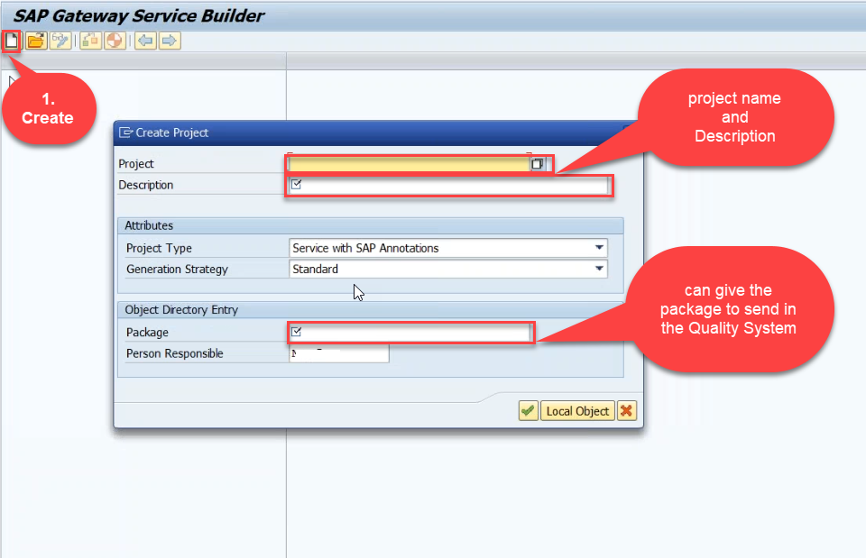
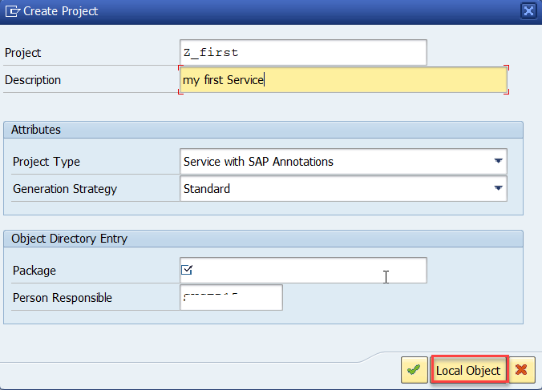
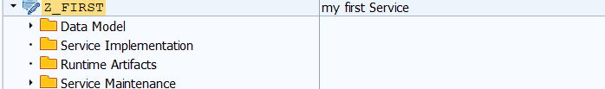
Creating OData Service Project
Step1: Start your SAP LOGON, and to Sap Gateway Service Builder(SEGW) and click on Create

Slide 15
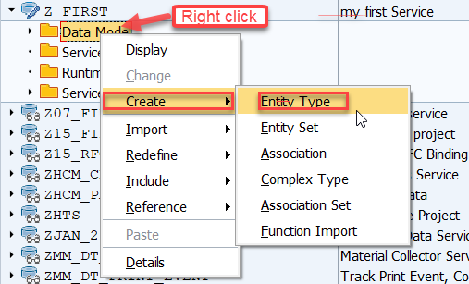
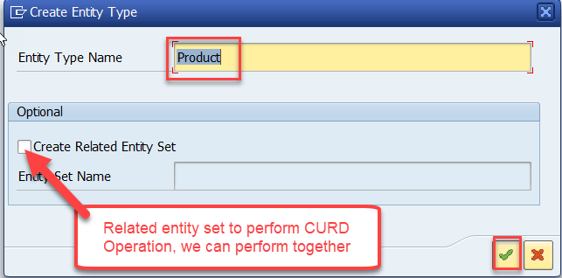
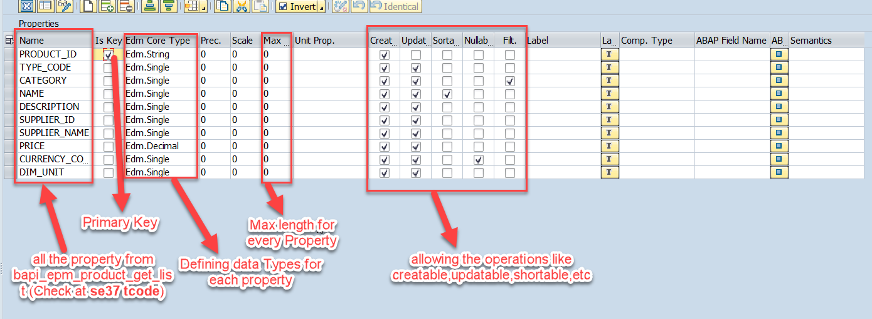
Creating OData Service Continue…
Step2: Defining the Data Model (Blueprint of data)
Step3: Creating Properties for data model (from bapi_epm_product_get_list (TCode- se37))

Slide 16
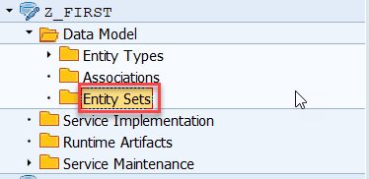
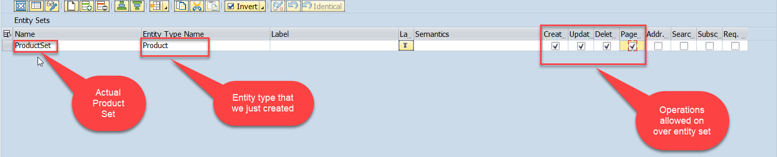
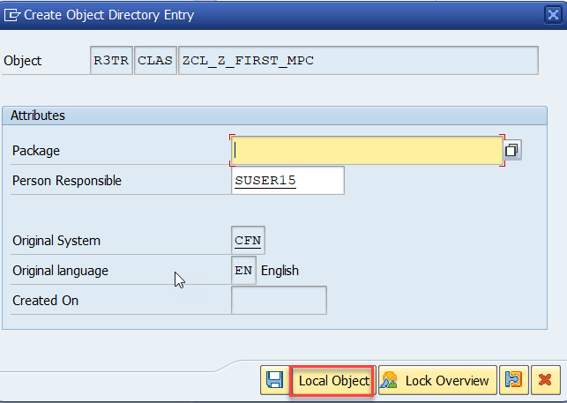
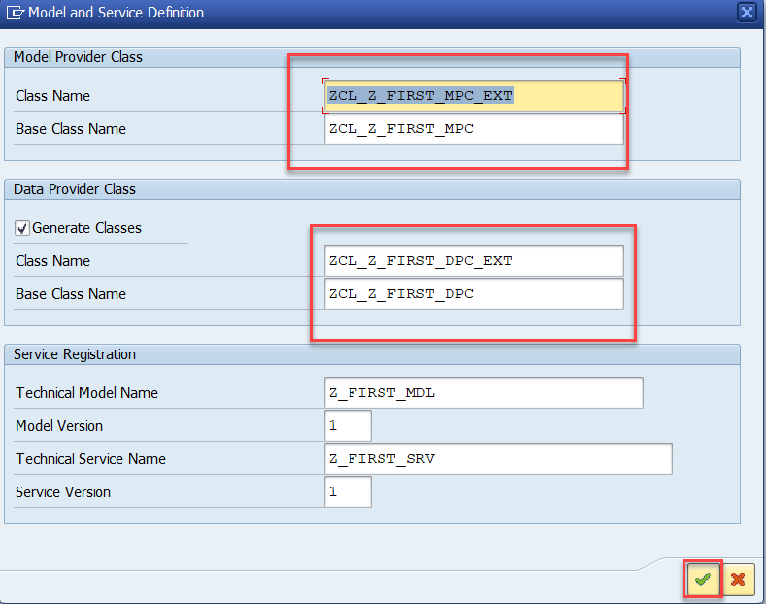

Creating OData Service Continue…
Step4: Creating entity set to perform actual CURD operations and service generation.
This is the name of your service

Slide 17
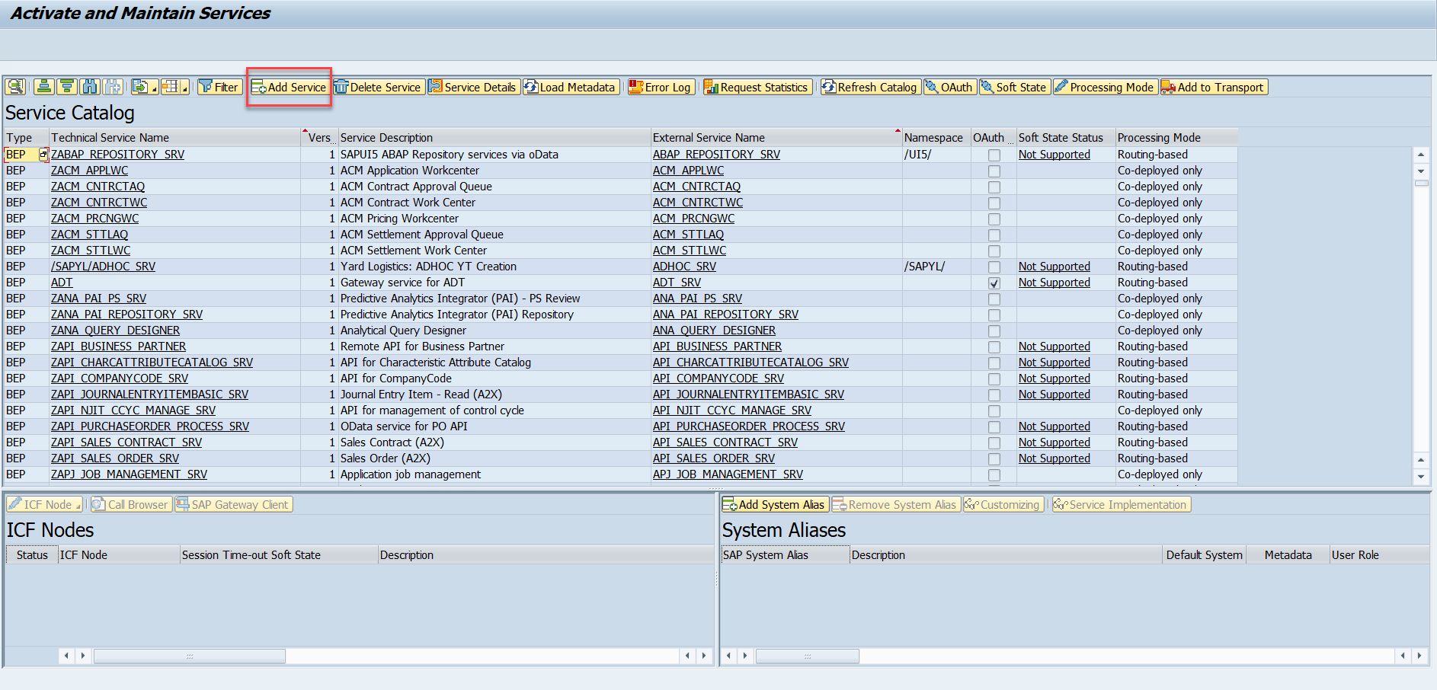
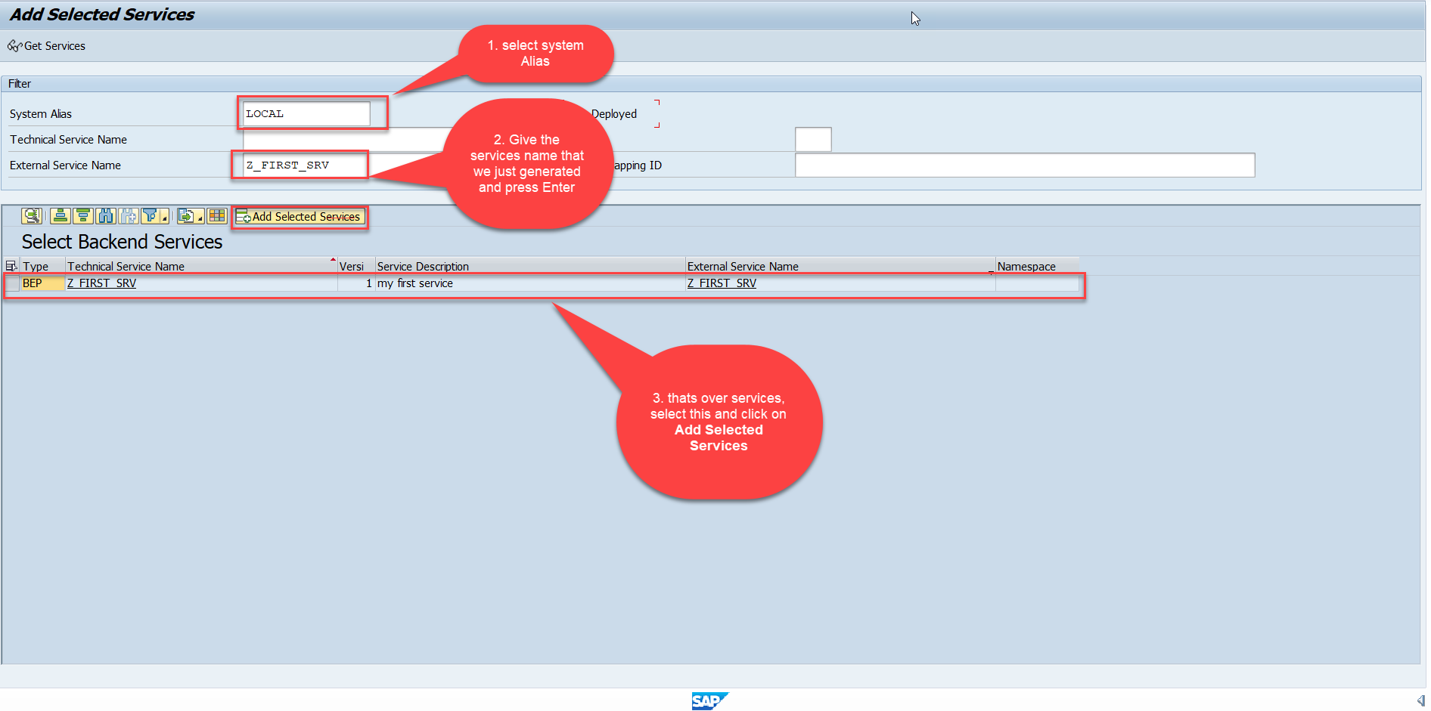
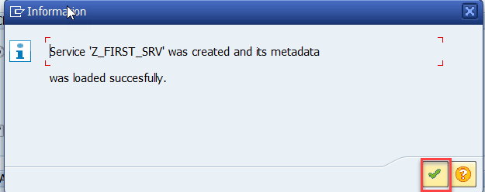
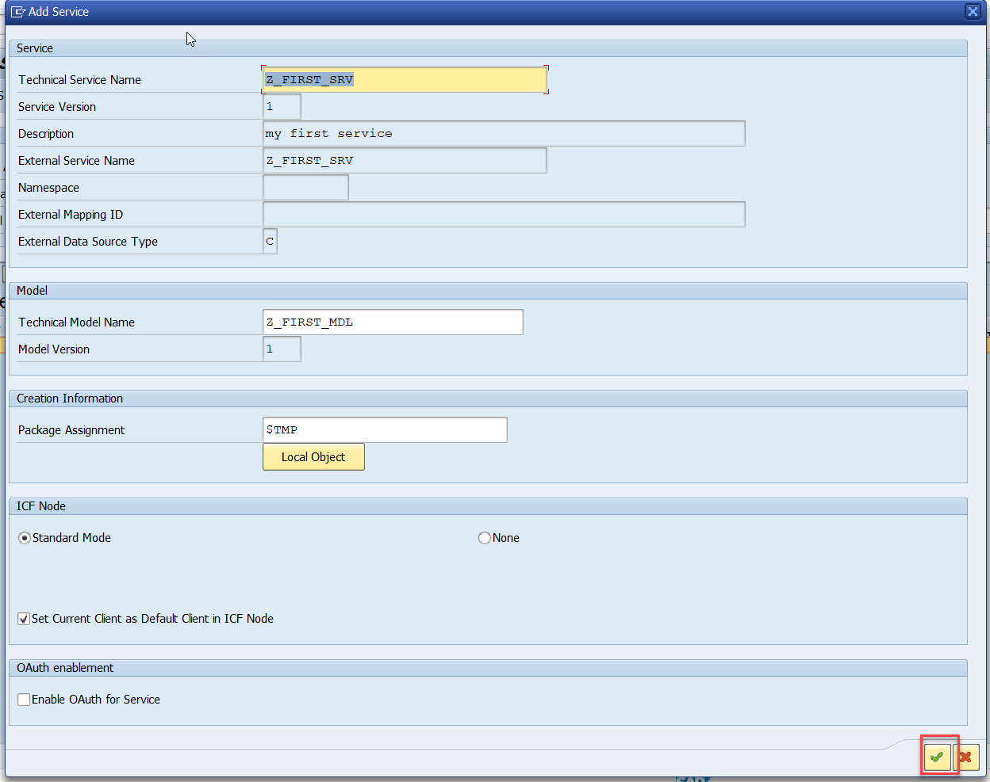
Creating OData Service Continue…
Step5: Service Registration (Go to tcode- /iwfnd/maint_service)

Slide 18
Hands-on: Creating First OData Service
Create your own first OData Service by following the steps written in the previous Slides.

Slide 19
Runtime Artifacts
When we create a service there are 2 types of code which developer/system needs
Metadata code – which serve metadata of the service, it will be generated by system automatically every time we change the service a new code will generate overwriting old code by SAP. This code is generated in MPC – model provider class
MPC = Model Provider Class (metadata) = where all the abap code will be generated which will have the code for metadata
Service Code – which is required as service implementation for performing CURDQ functionality. This code will be written by developer in a class called DPC = Data provider class.
DPC = Data Provider Class (data operations CRUDQ) = Contains all the implementation of CURDQ. It will get for each entityset 5 methods.
What if a developer need to customize the SAP generated code
SAP
Model provider class MPC class
Data Provider class
DPC class
Metadata
Types of entities
Whenever a entitySet is created, in Each entity 5 methods will be created –
OBJECT_GET_ENTITYSET
OBJECT_GET_ENTITY
OBJECT_CREATE_ENTITY
OBJECT_UPDATE_ENTITY
OBJECT_DELETE_ENTITY
PROJ_SRV
MPC_EXT
Here we should write our code
DPC_EXT
CURD Functionality

Slide 20
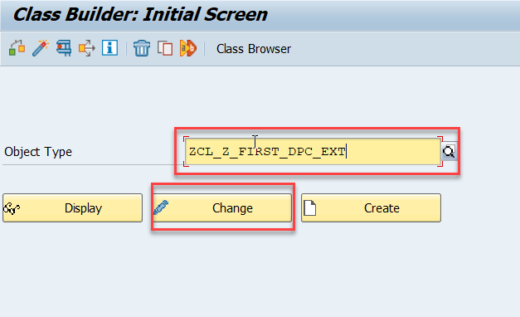
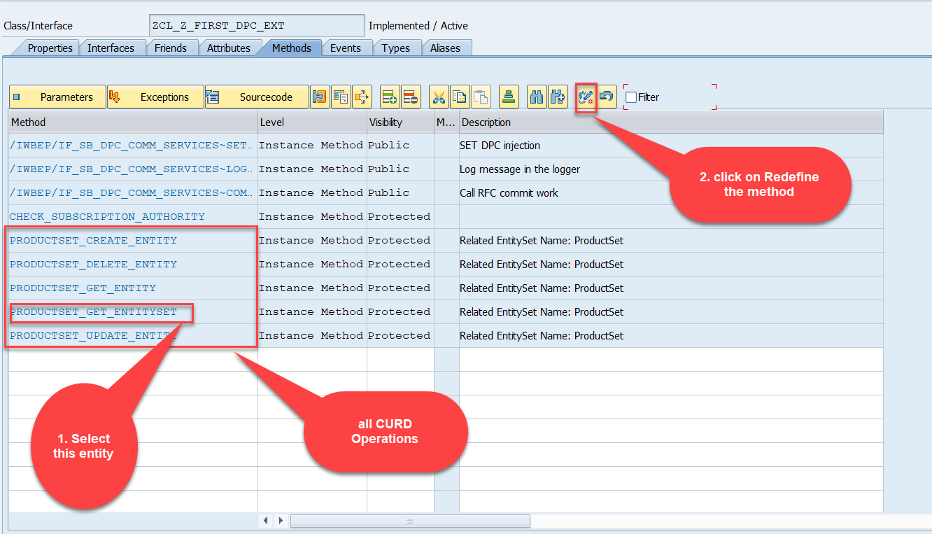
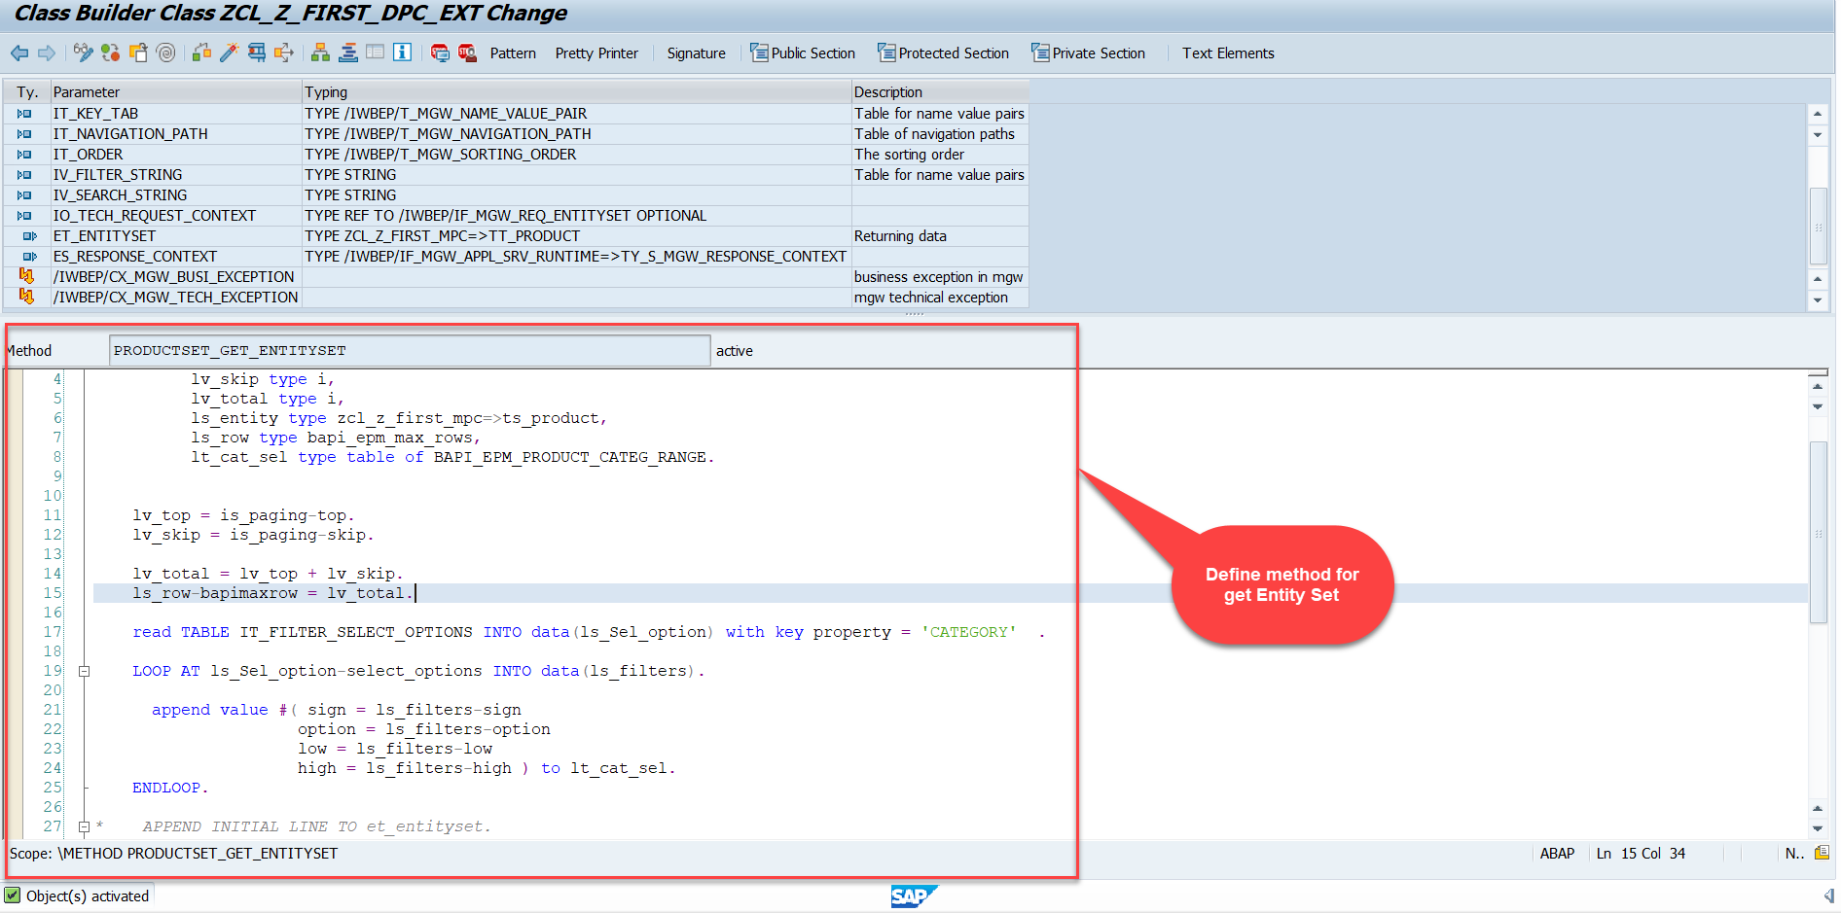
Building Get Entity Set Method for ProductSet
ProductSet Get EntitySet method(with filter, top and skip) in DPC Extension (Class Builder tcode- se24)
After adding the code just activate the service.
Code for PRODUCTSET_GET_ENTITYSET:
GetEntitySet

Slide 21
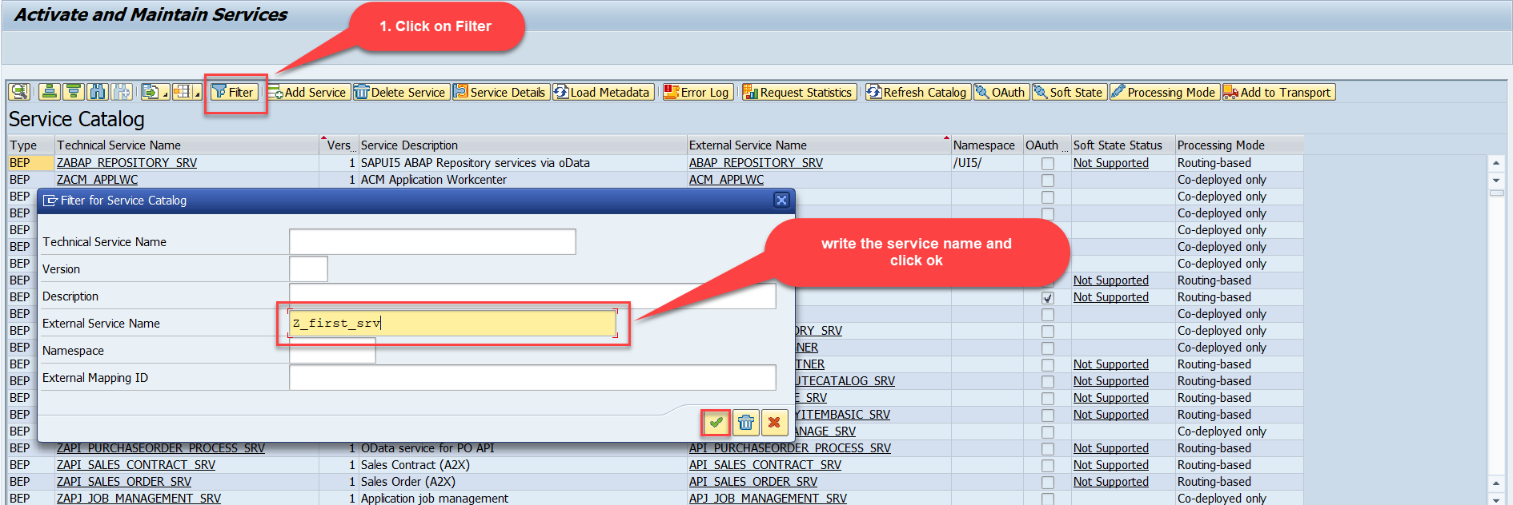
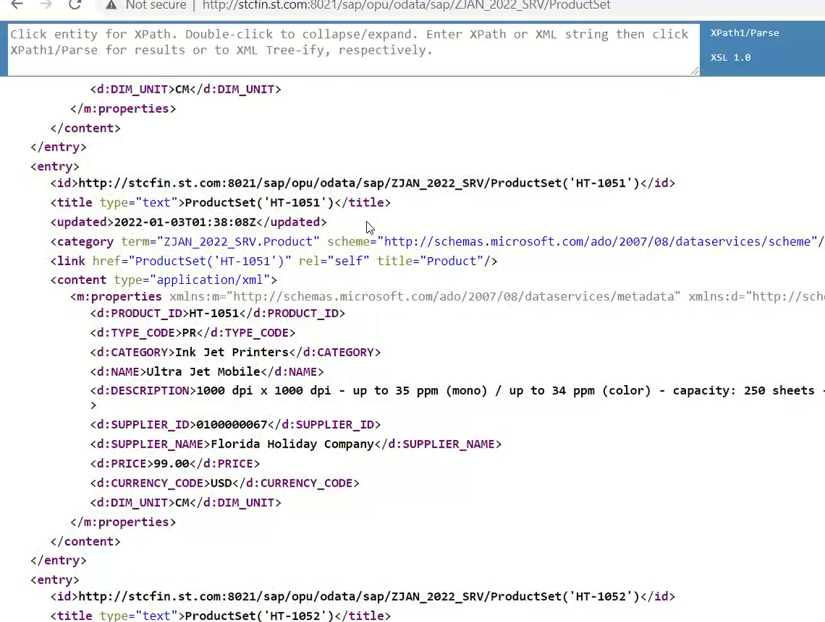
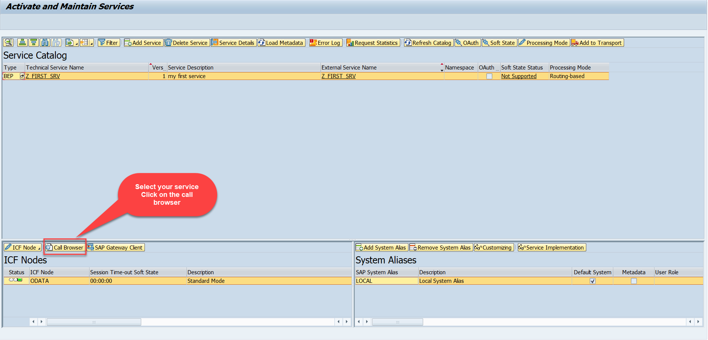
Test the Get Entity Set in Browser
Now enter the Tcode - /n/iwfnd/maint_service and, there search our service using the filter option.
Now select the service and press the Call Browser button to open it in the Browser window.
Just add /ProductSet at the end of the service to call the get product get entity set method
Calling the ProductSet in browser

Slide 22
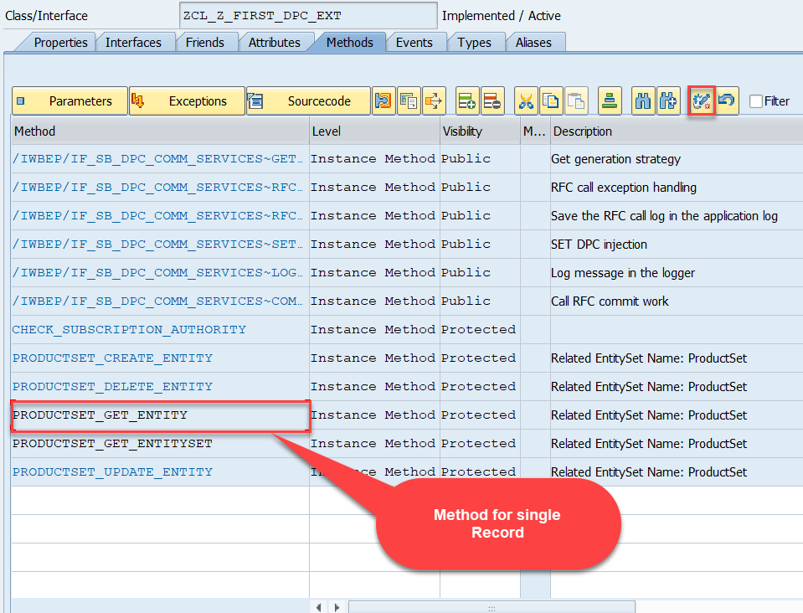
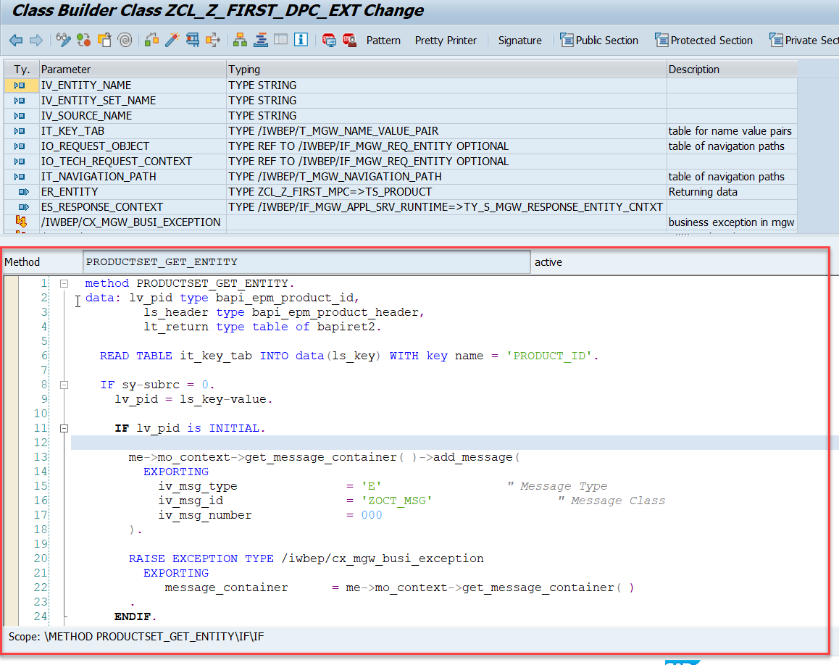
Building Get Entity Method
Go to DPC Extension class of our service and redefine the method PRODUCTSET_GET_ENTITY and put the below provided code.
Code for PRODUCTSET_GET_ENTITY:
GetEntity

Slide 23

Postman
Postman is a free tool which can be used to test any kind of REST/OData Services outside of the system. This allows us to consume the data as if an external consumer would really do.
Postman is an API platform for building and using APIs. Postman simplifies each step of the API lifecycle and streamlines collaboration so you can create better APIs—faster.
As an ABAP developer, you can develop postman collection and deliver it to Fiori Developers for consumption to showcase, what our service is capable of.
Postman can run GET, POST, PUT, PATCH, MERGE, DELETE, and various other request methods as well, and has utilities to help with developing APIs. Free and paid versions are available for Mac, Windows, Linux, and as a Chrome app.
You can Download the postman tool from the link give below: https://www.postman.com/downloads/

Slide 24
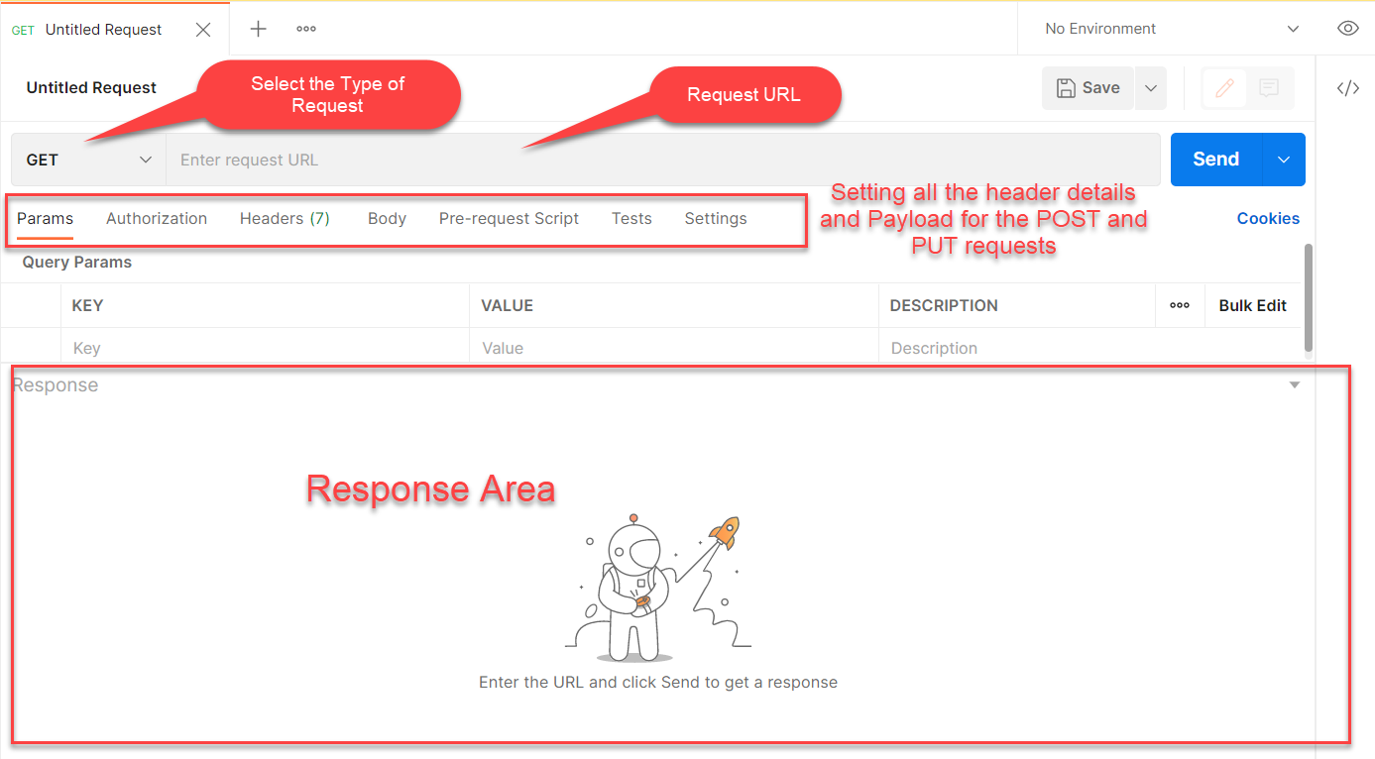
Postman App Layout
The below screen shot shows a basic layout of a request in Postman

Slide 25
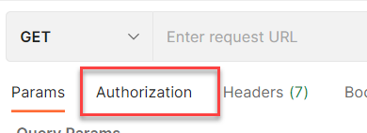
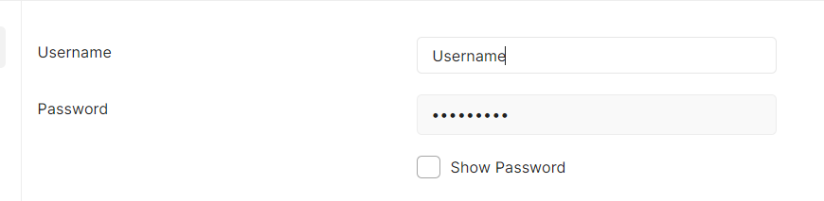
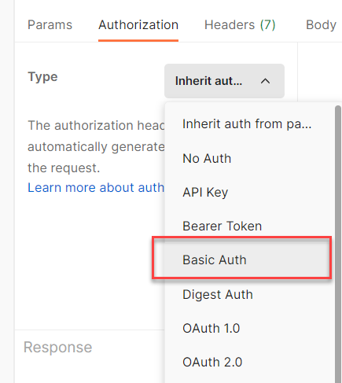
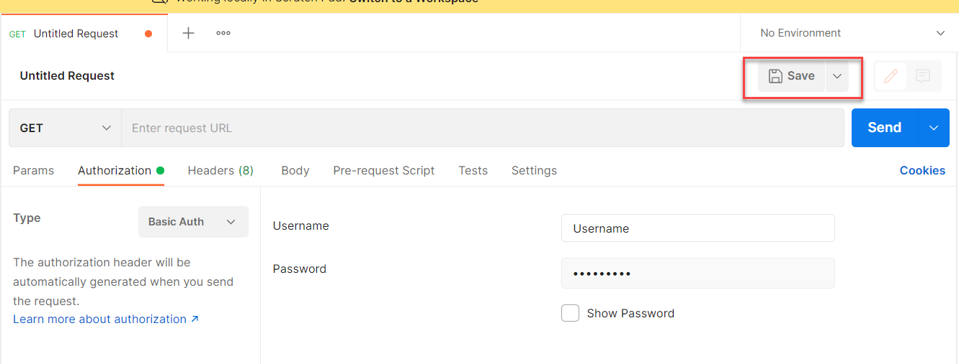
Setting Basic Auth in Postman
Step 1: Go to the Authorization section.
Step 3: Set the Username and Password.
Step 2: Select Basic Auth as Type
Step 4: Save.

Slide 26
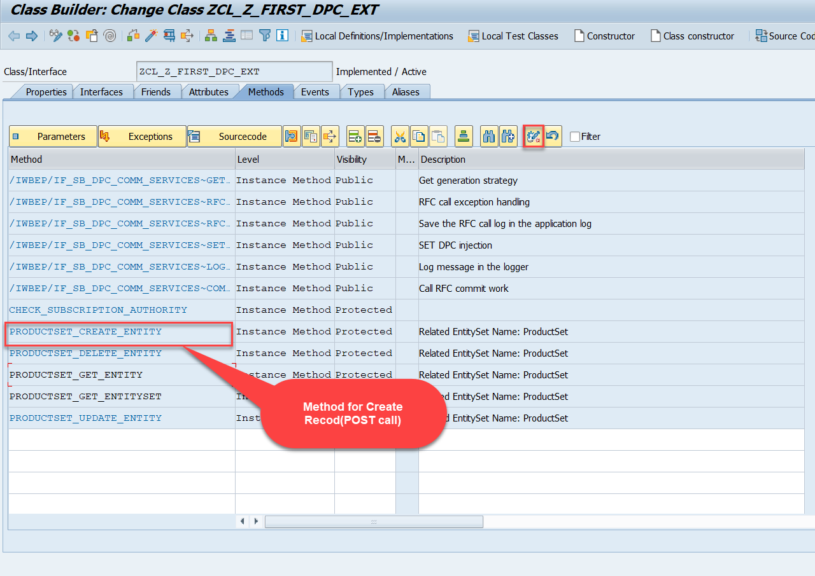
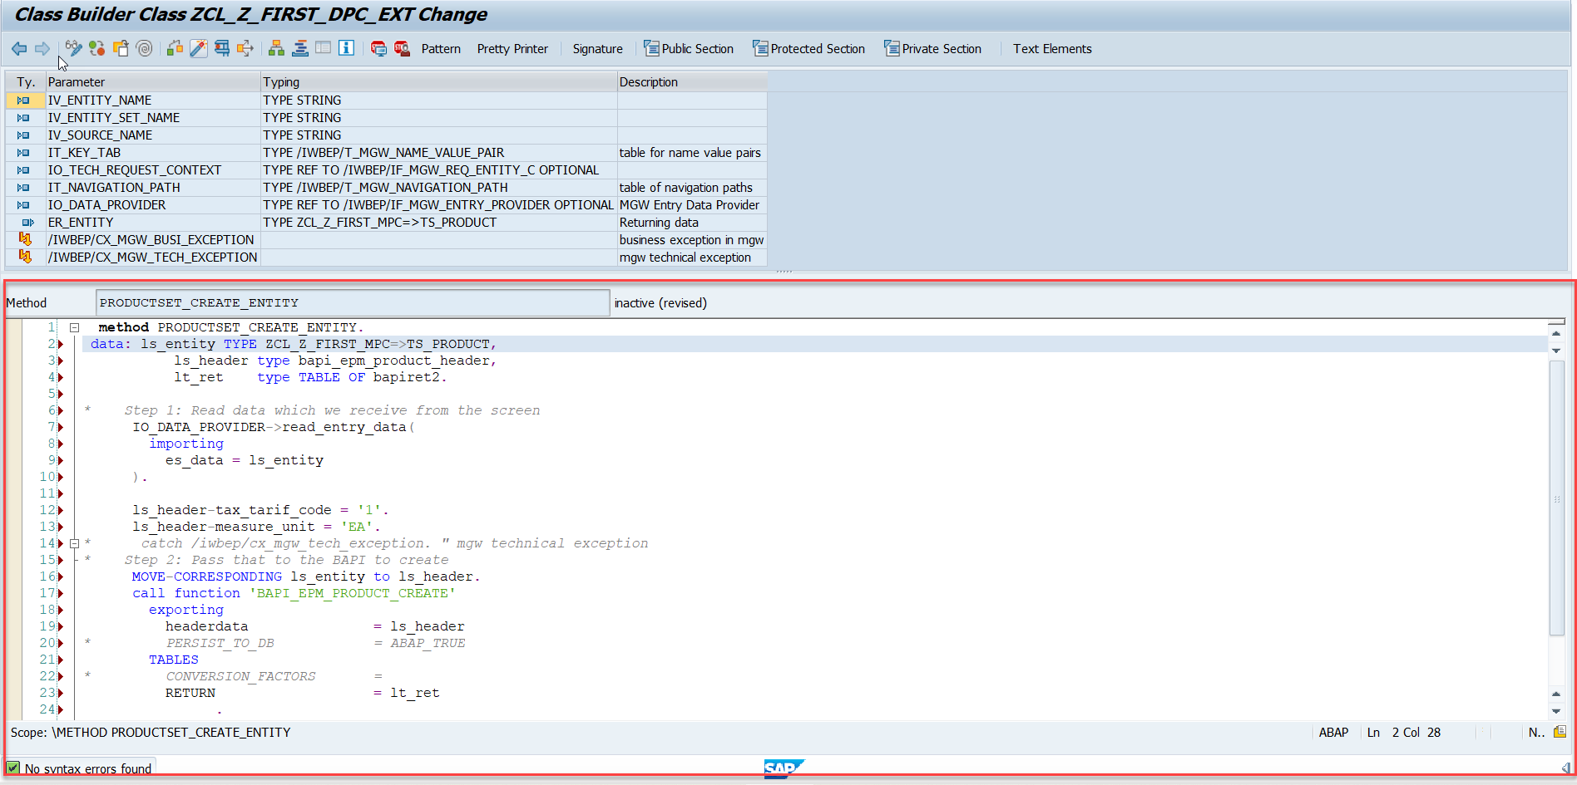
Building CreateEntity(POST) Method
To implement the Create operation in our odata service, go to DPC Extension class of over service and redefine the method PRODUCTSET_CREATE_ENTITY
Code for PRODUCTSET_CREATE_ENTITY: CreateProductEntity

Slide 27
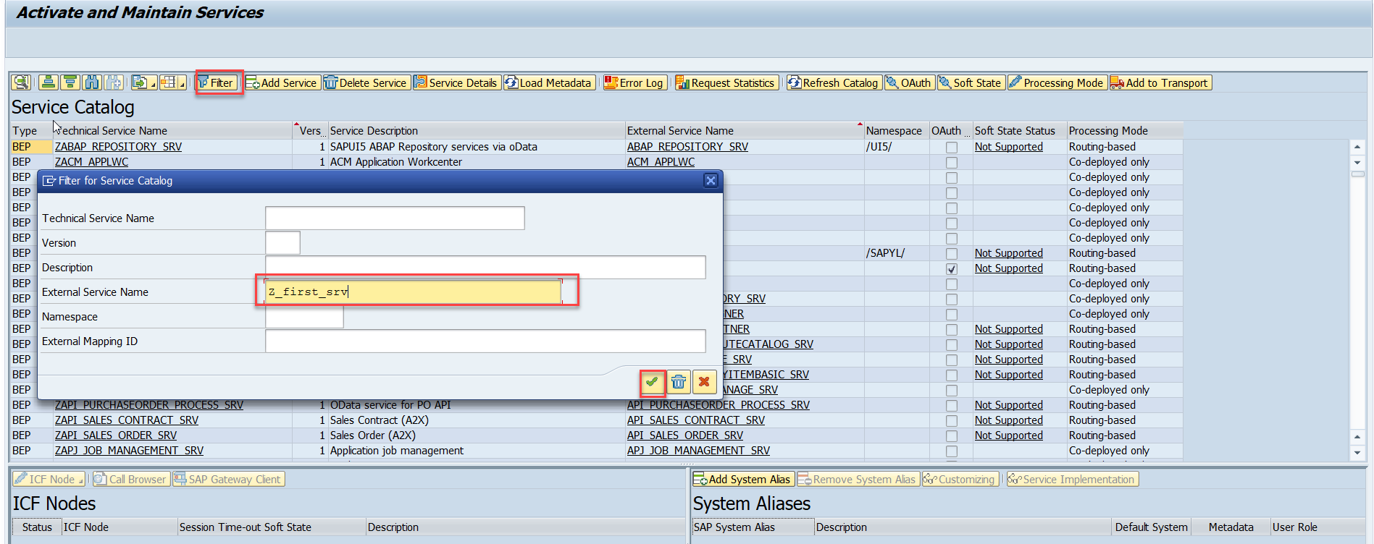
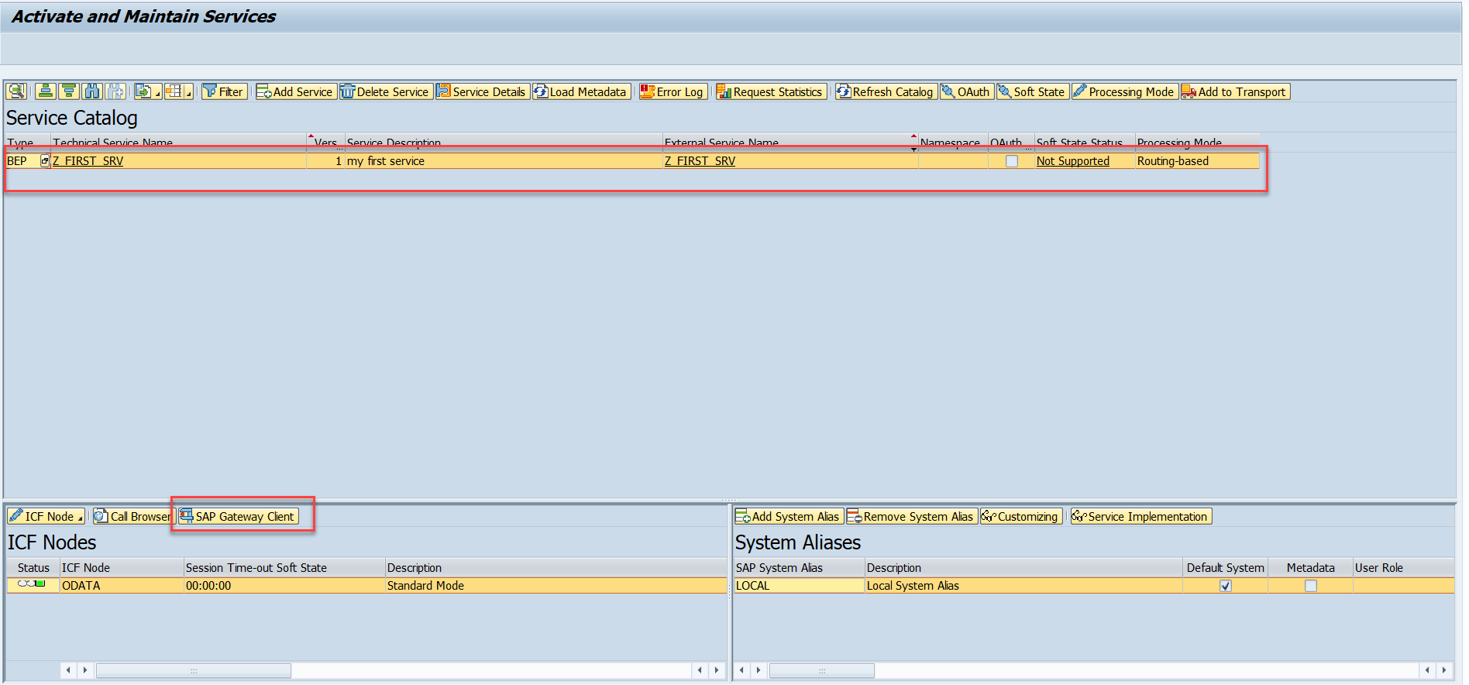
Testing Create Method at Sap Gateway client
Step:1 Go to sap service maintance(tcode- /iwfnd/maint_service) and search for the service and then select the service and click on the sap gateway client

Slide 28
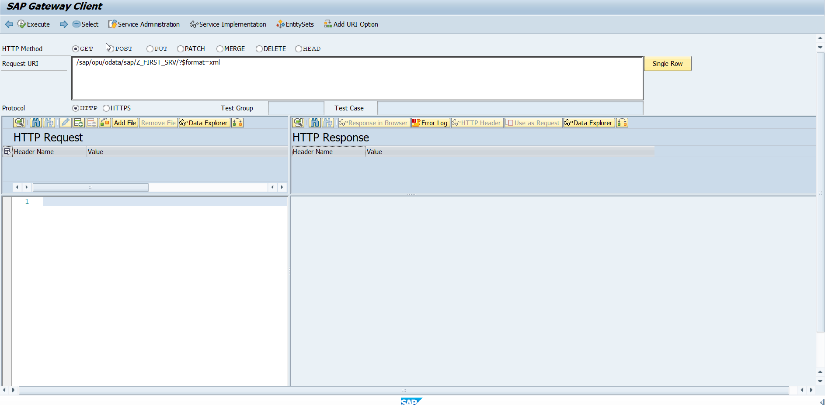
Testing Create Method Continue…
Step:2 Go to sap service maintance(tcode- /iwfnd/maint_service) and search for the service and then select the service and click on the sap gateway client

Slide 29
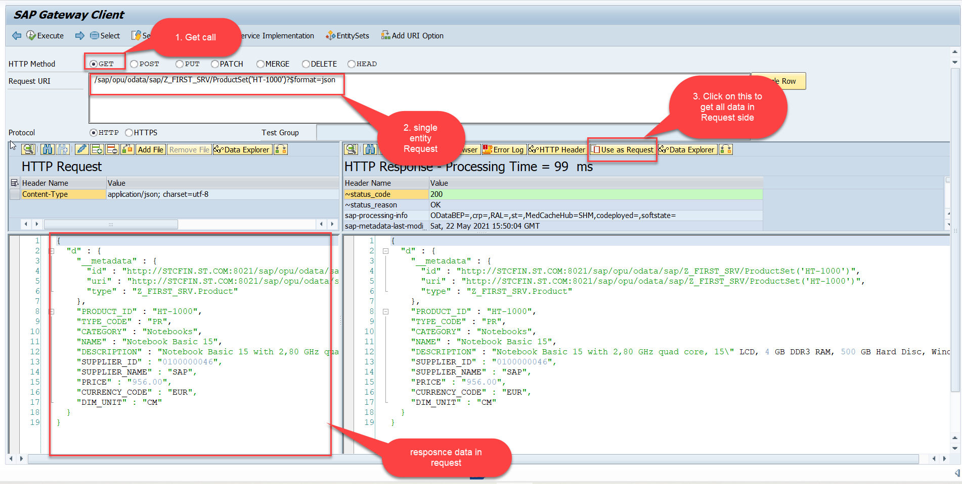
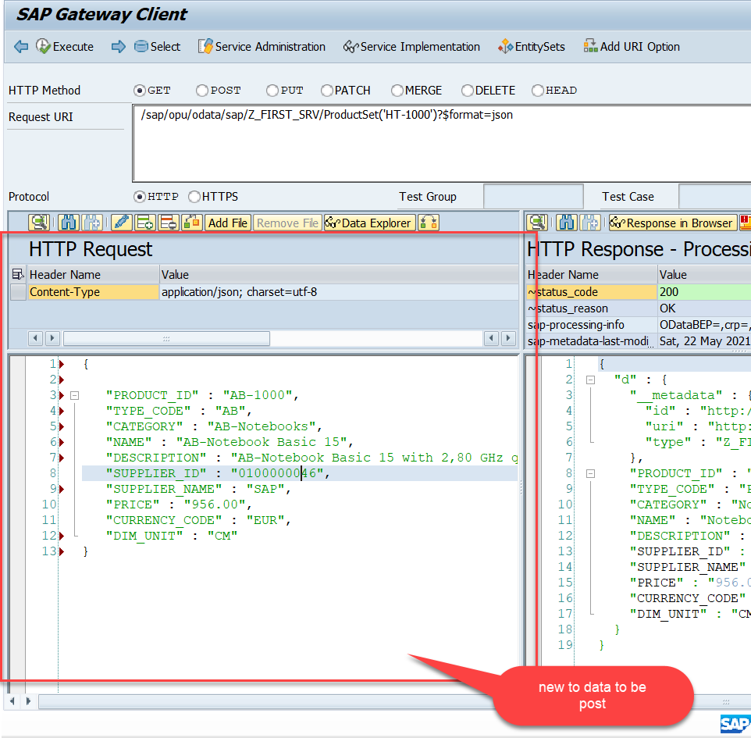
Testing Create Method Continue…
Step:3 Perform a getEntity in the Product set to get the payload to post (/sap/opu/odata/sap/Z_FIRST_SRV/ProductSet('HT-1000')?$format=json) and then clean the data and modify the payload as new.

Slide 30
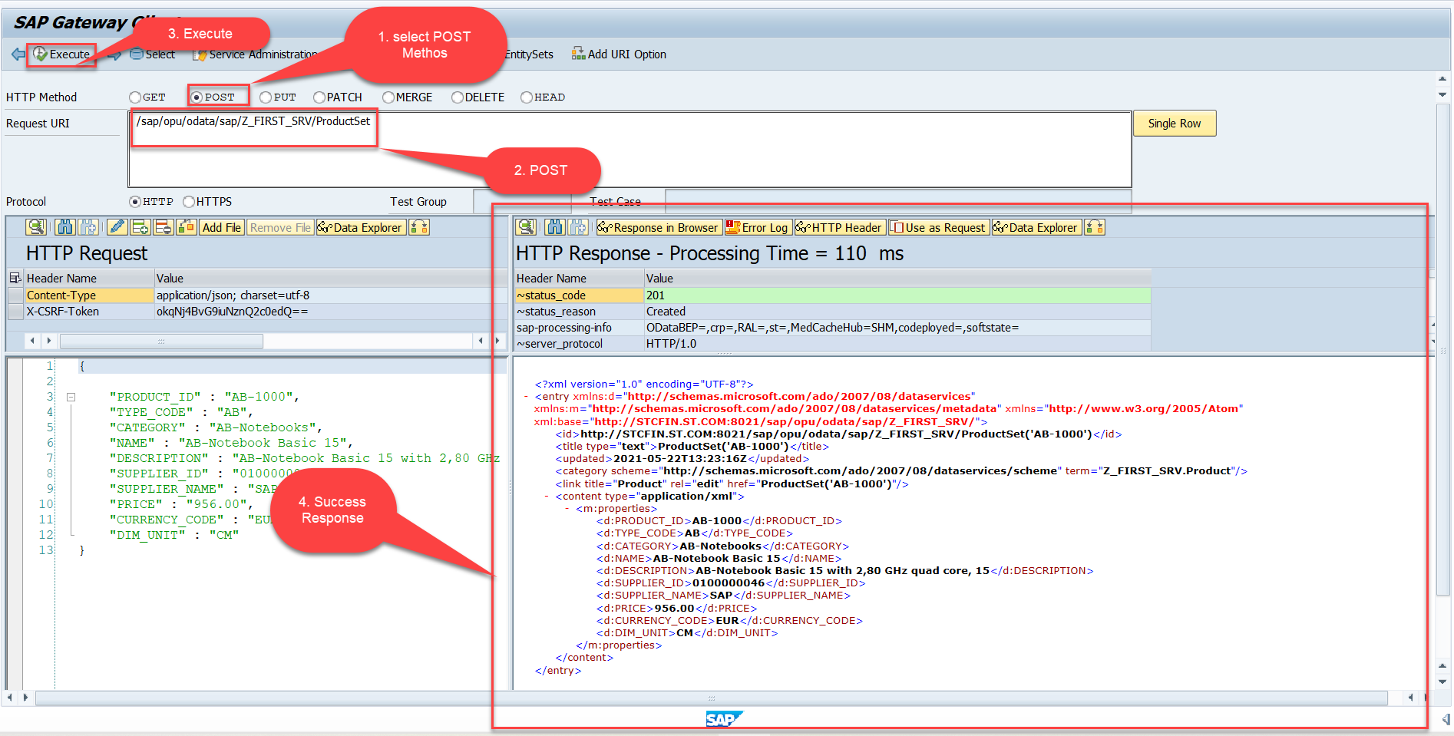
Testing Create Method Continue…
Step:4 send the post request at (/sap/opu/odata/sap/Z_FIRST_SRV/ProductSet)

Slide 31
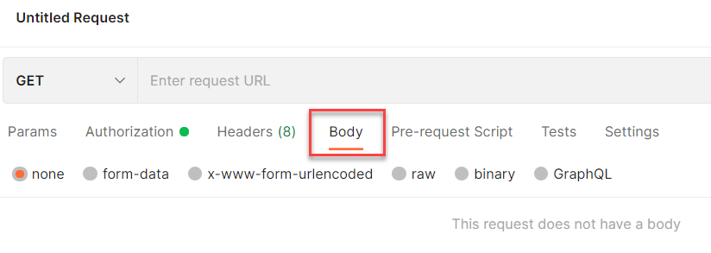
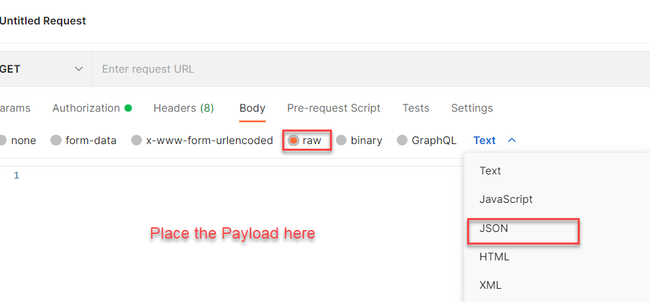
Setting the Payload for POST and PUT request
Step 1: Go to Body Section.
Step 2: Select the raw option form the radio button and then select the data type as JSON.

Slide 32
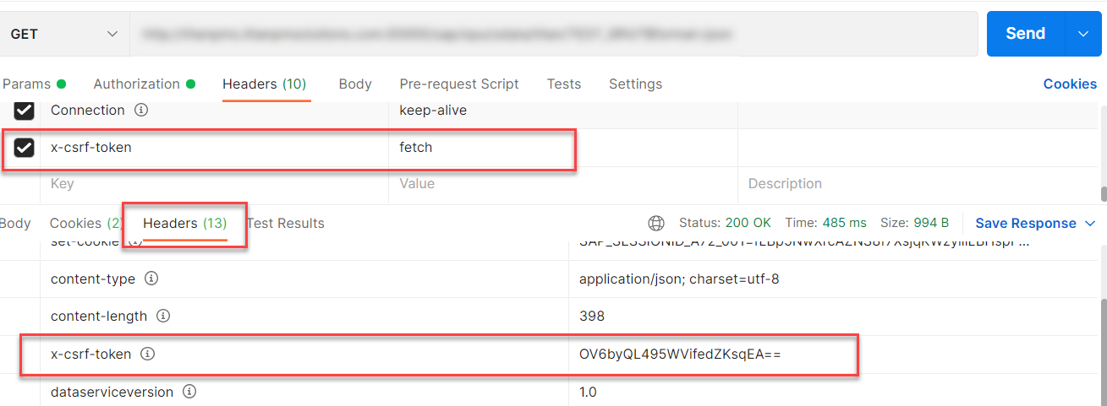
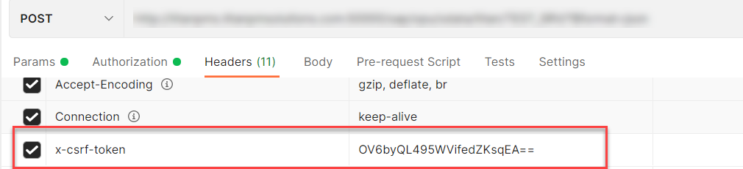
X-CSRF Token
A CSRF Token is a secret, unique and unpredictable value a server-side application generates in order to protect CSRF vulnerable resources.
The tokens are generated and submitted by the server-side application in a subsequent HTTP request made by the client.
Steps to Get the x-csrf token.
To get the x-csrf token we need to pass the value of x-csrf token as fetch with the GET call.
After executing the get call we will find the token in the Header Section of the Response.
- In POST call we need to pass this value of x-csrf token in the header section.

Slide 33
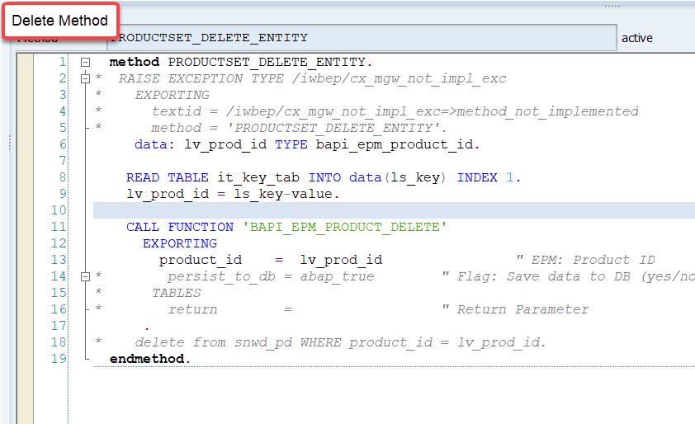
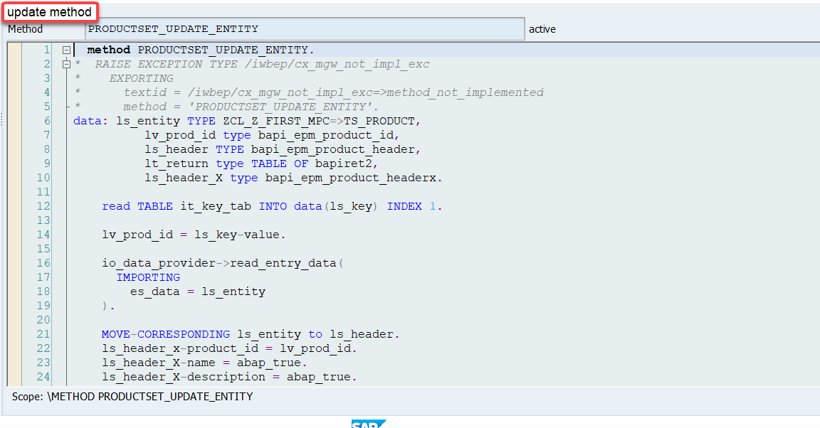
Implementing DELETE and Update (PUT) method
We can implement the delete and update method in the corresponding DPC extension classes.
Code for PRODUCTSET_DELETE_ENTITY: ProductSetDeleteEntity
Code for PRODUCTSET_UPDATE_ENTITY : ProductSetUpdateEntity

Slide 34
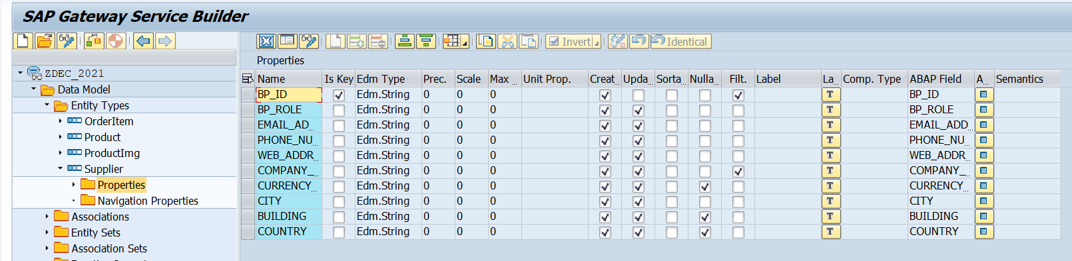
Create Supplier Table
Create a Supplier entity Set in the Entity Type Section by following the steps used to create Product entyity Set.
Supplier Set
Once the Entity sets are created, we can also implement the Get Entity for of Supplier Set in the same way as we have created for the Product Set.
Code to put in Supplier Set Get Entity:
SupplierSetGetEntity

Slide 35
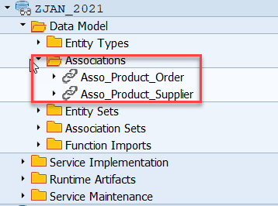
Association
Associations are relationship Between entities.
At database level we have foreign key relationship and same is reflected at odata level.
Once a association is created only then we can create navigation property.
In a typical ERP system the data is spread across multiple database tables. Example sales order header and items. We load this connected data using the foreign key relationship.
In case of OData service, each database table is transformed into an entity. Hence we also need a relation between these entities. So the foreign key is converted to a association.
Product
Supplier
1 relation 1

Slide 36
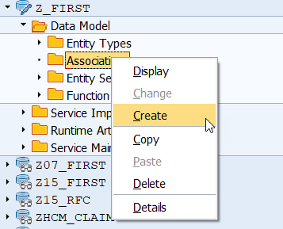
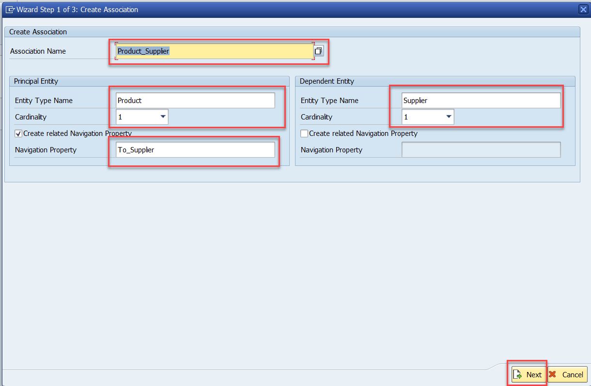
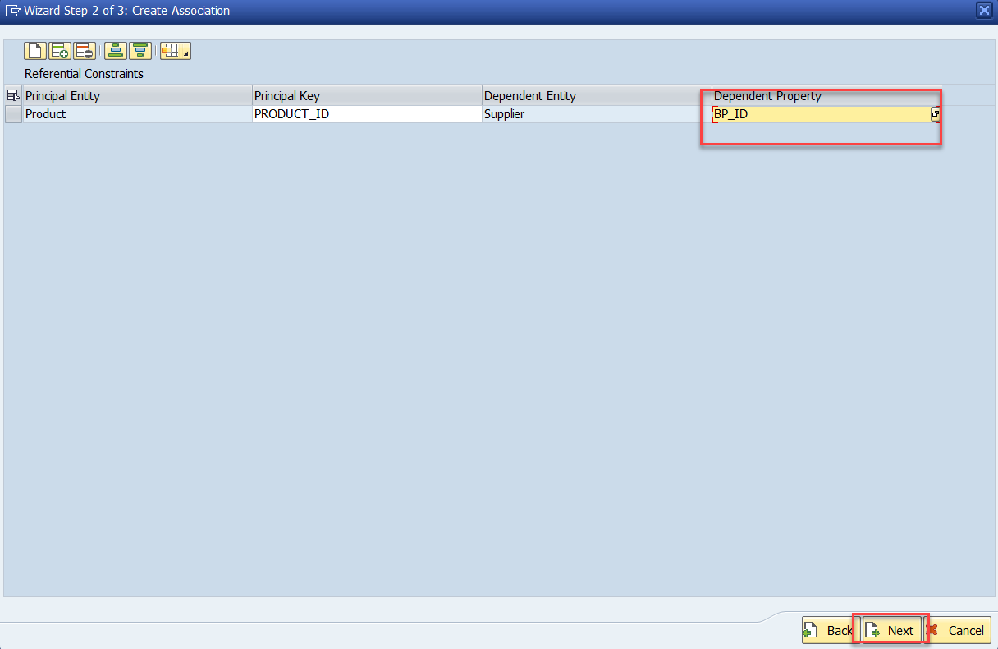
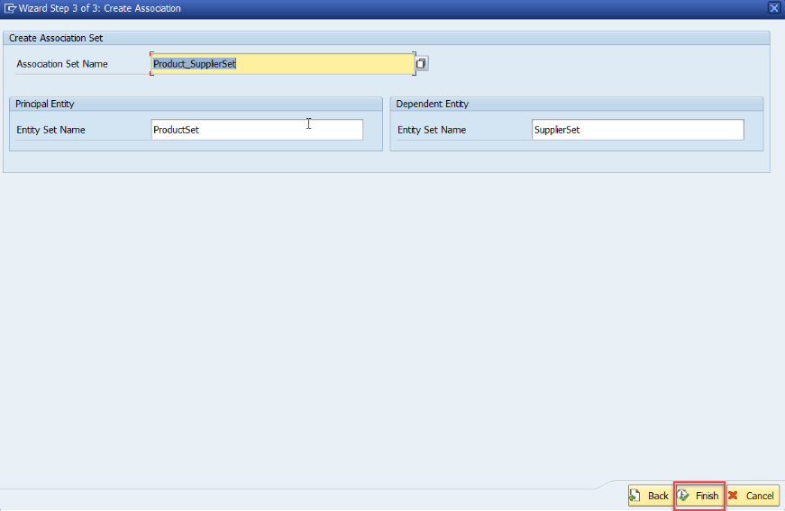
Association (1:1)
Step:1 Right Click on Association and click on create
After creating the Association for Supplier Set in Product Set, we need to change the Supplier Get entity.
Code Link:
SUPPLIER_GET_ENTITY (Association)

Slide 37
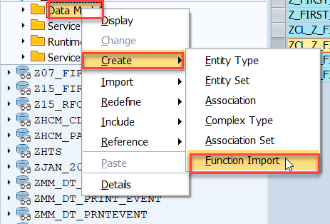

Function Import
At times, we need to implement the logic inside of OData which is not a direct CRUD operation e.g. calling a workflow, calling a BAPI which does some processing, Sending request to another server and can be invoked by the HTTP methods GET or POST .
For example: we can create the function import to GetMostExpensiveProduct in our Product set by the Category.
Step1: Right click the Data Model folder and select Create and then select Function Import. Create Function Import dialog opens

Slide 38


Function Import
Step2: Enter return type kind, return type, return cardinality & HTTP method Type
Step3: Giving function import parameters (I_CATEGORY)

Slide 39


Function Import
Step4: Go to DPC Extension and search for the method--/IWBEP/IF_MGW_APPL_SRV_RUNTIME~EXECUTE_ACTION and redefine the class method
Function Import Code: funciton_import

Slide 40

Basics of Connectivity and Role of SCC
Internet
Intranet
SAP BW
SAP ECC
SAP S/4 Hana
SAP BTP (PublicCloud)
SAP Cloud Connector
SAP On-premise System
SAP Business Application Studio
SCC
Destination
S/4 Hana Cloud
Field Glass
Sales Force

Slide 41


Cloud Connector
Step 1: Download SAP JVM and Extract it in the C:\Program Files\Java

Slide 42






Cloud connector continue…
Step 2: Download and install the sap Cloud connector

Slide 43


Cloud connector continue…
Step 3: Now your system is ready go to browser and open https://localhost:8443 (port may changes)
The default credentials are Administrator / manage

Slide 44

Cloud connector continue…
Step 4: Now we create a connection with our Cloud Account

Slide 45

Cloud connector continue…
Step 5: Check the connection on Hana Cloud Account

Slide 46








Cloud connector continue…
Step 6: Connect on-premise system to cloud using SCC

Slide 47

Cloud connector completed
We have Done with Connect , now we are now successfully connected to cloud using SCC.

Slide 48

Creating the Destination in BTP
Now once the cloud connector setup is done. We need to create a destination in the Business Technology Platform (BTP) to assess our SAP system in the BAS.
There are two ways to create a destination in BTP:
Create a destination directly in BTP (Not Recommended)
Creating the destination inside the BAS (Recommended)
To create a destination directly in BTP
Go to the Connectivity > Destinations and here click on New Destination
Then a new Destination Configuration will open.
Enter all the details of the system and press save.
After that check the connection with destination.
This way of creating destination is not recommended because in this method, to assess the odata service in the fiori application some additional properties are required. Adding that properties is a little tricky and can lead to error.
That’s why we will not use this method.

Slide 49





Creating Destination Inside BAS
To create the destination directly using BAS follow the step:
Start your BAS tool and in that go to the service center in the left side bar.
Then under the SAP SYSTEM section choose your subaccount and click on plus button +
Fill the details as shown and press Add. You can create a new Project for the template to test this destination.

Slide 50



Connecting system to the VSCode
Now if we want to connect our system to the vscode we don’t need the Cloud Connector, because the VS code is already running in our local system and in our local system we can use the VPN to access our SAP System.
So to connect vs code to the system:
Open application generator using the command palette.
Create any type of project (let’s select the master detail).
In the Data Sources as Connect to a System
In system select New System and system type as ABAP on Premise
And then Enter the system detail.
Then complete the project setup.
After that you can see the created system in the Fiori Tools option in the left side bar, under the SAP SYSTEM.

Slide 51

End of Day 16

Slide 52

Questions

Slide 53

Sakshi Gupta

Slide 54


We’re committed to empower you to be
Most Desirable Resource
through powerful training solutions.
We build the workforce of the future.
250+
Corporate Clients
30,000+
Learners Trained
25000+
Learners Placed
FREE WEBINARS
Sign up for free webinars with industry experts every fortnight!
Enroll Now!
Contact us today!
https://anubhavtrainings.com/

Slide 55




More from AnubhavTrainings.com

Slide 56
Title
Content

